Slide 1
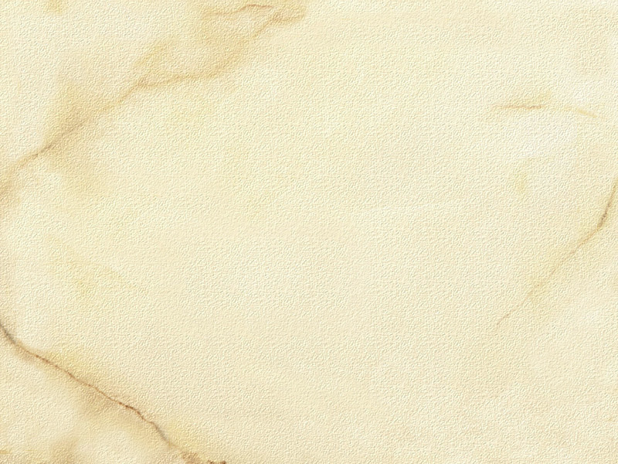
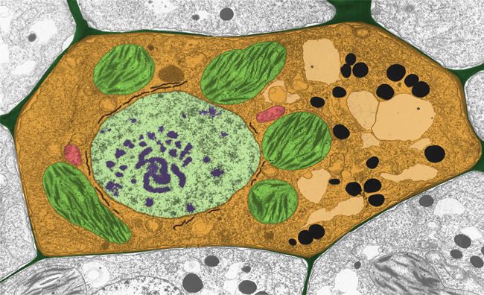
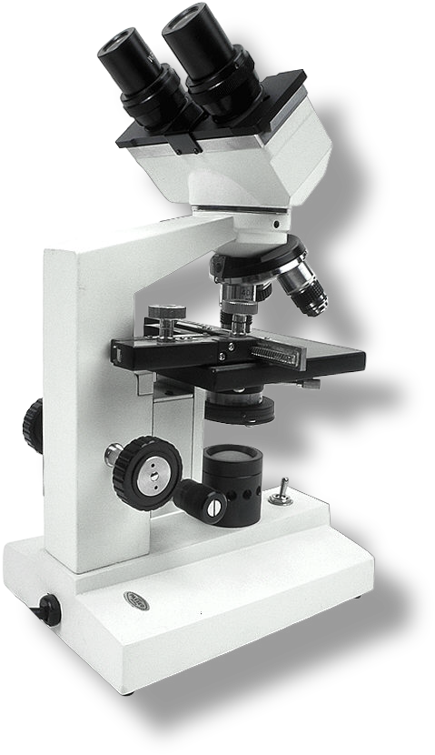
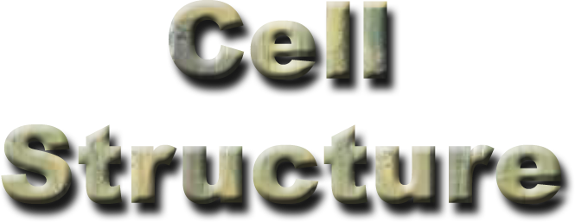

Cell Biology & Biochemistry Series:Set 3
Version: 1.0

Slide 2

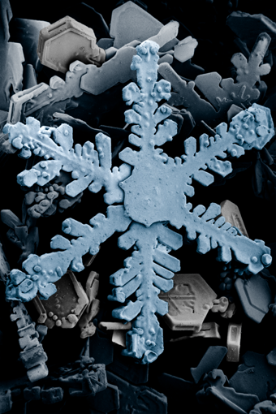
Introduction to Microscopy
Microscopy is the use of any technique which produces a visible image of a structure which is too small to be seen in detail by the human eye.
The invention and use of the microscope has resulted in the development of many scientific theories.
Microscopes are a fundamental tool used in biological sciences.
USDA
This image was captured using low temperature scanning electron microscopy (SEM). The structure would not be visible without the use of microscopy. What is it?

Slide 3
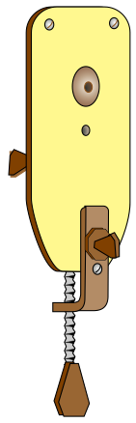
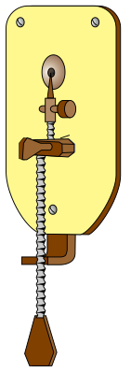
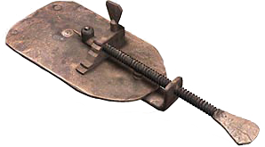
Early Microscopes
Antoni van Leeuwenhoek designed and built over 500 single lens microscopes.
They provided a magnification of 270 times.
Bacteria, protozoa, human blood cells and spermatozoa were discovered using them.
By today’s standards the Leeuwenhoek microscopes (right and below) are regarded as glorified magnifying glasses.
Single lens sandwiched between two brass plates riveted together.
Specimen holder
Focus adjustment
Screw thread adjustment moves specimen across the field of view.
Front view
Back view

Slide 4
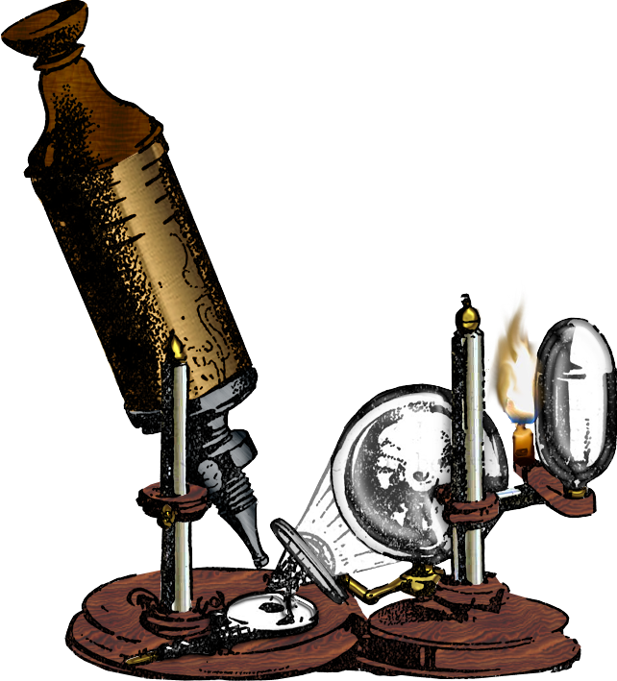
Robert Hooke
Robert Hooke described the use of a compound microscope (left) he devised in 1665.
He was the first to coin the name “cell” after he observed the angular spaces that he saw in a thin section of cork.
Microscope
Mirror
Lamp

Slide 5

Compound Microscopes
The compound microscope (right) is a fundamental tool used in biology.
High powered light microscopes are used to magnify objects up to 1500 times.
  They are called compound microscopes because there are two or more separate lenses involved.
Thin and mostly transparent samples are required so that the light from the microscope can pass through the sample easily to reveal the detail.

Slide 6
Compound Microscope
Eye piece lens
Objective lens
Arm
Mechanical stage
Coarse focus knob
Condenser
In-built light source
Fine
focus knob

Slide 7
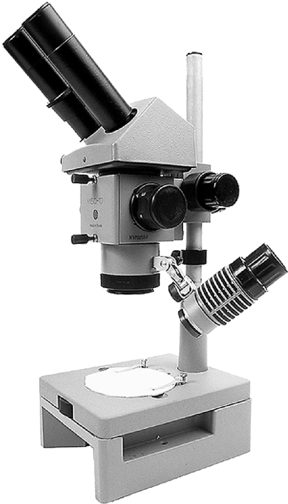
Dissecting Microscopes
Dissecting microscopes (such as the one shown right), are a type of binocular microscope.
They are used at a low magnification
(X4 to X50).
A dissecting microscope has two separate lens systems, one for each eye.
A 3-D view of the specimen is produced.
  Because of this they are sometimes called stereo microscopes.

Slide 8
Dissecting Microscopes
Eyepiece lens
Height adjustment knob
Eyepiece focus
Focus knob
Objective lens
Light source
Stage

Slide 9
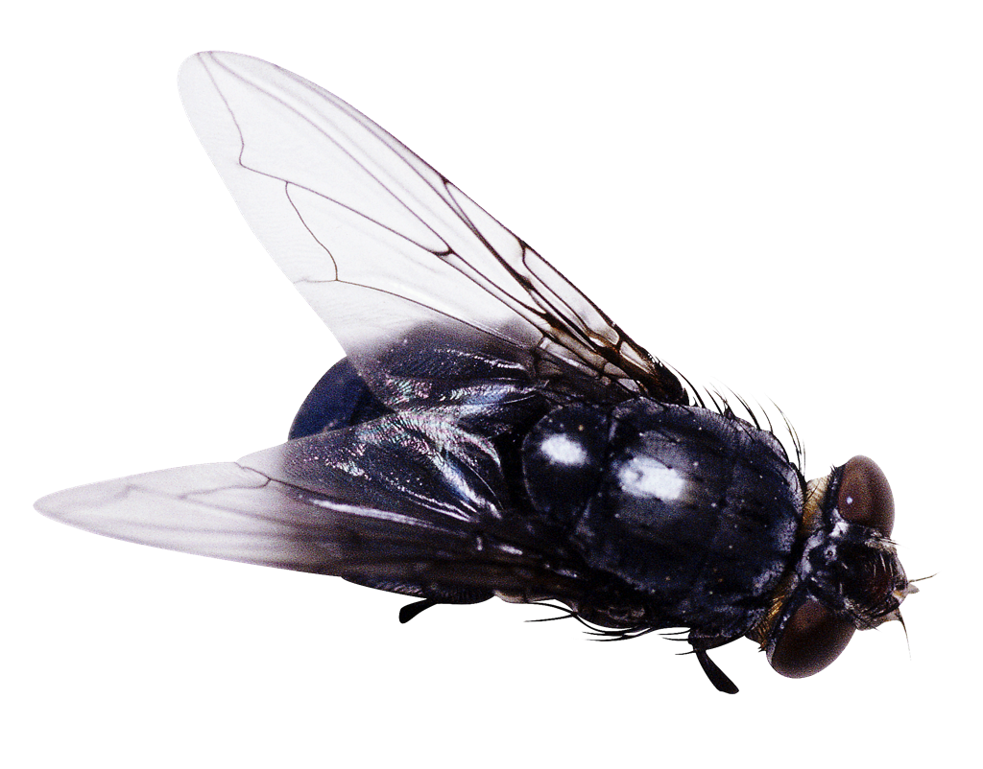
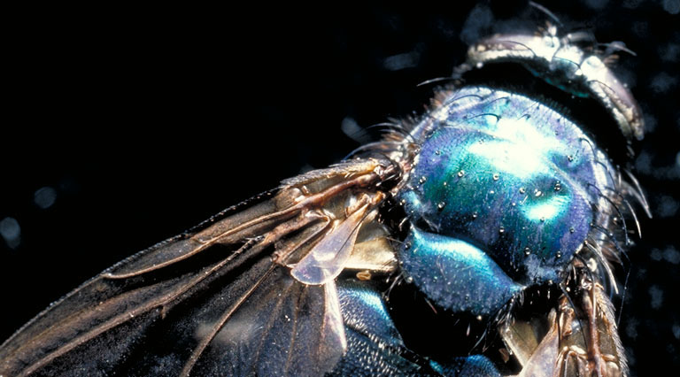
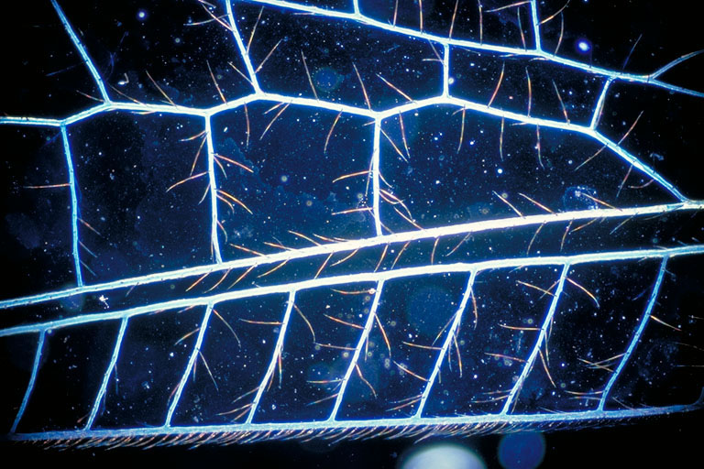
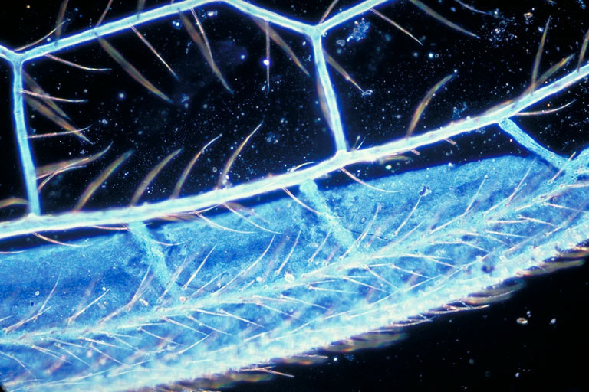
Magnification
A blow fly: actual size - no magnification
Magnification refers to how much larger a sample appears to be compared to its actual size.
As magnification level increases so does the blurriness of the sample.
x5 magnification
x20 magnification
x50 magnification

Slide 10
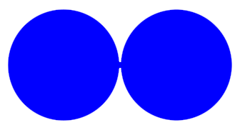


Resolution
An important factor determining the usefulness of a microscope is its resolving power or resolution.
Resolving power is a measure of the clarity of the image. It is the minimum distance two points can be separated and still be distinguished as two separate points.
  For example, what appears to the unaided eye as one star in the sky may be resolved as two stars with the use of telescope.
  Electron microscopes have a greater resolution than optical microscopes because electron beams have wavelengths much shorter than those of visible light.
Examples of high, medium and low resolution for separating two objects viewed under the same magnification are shown right.
High resolution
Medium resolution
Low resolution

Slide 11
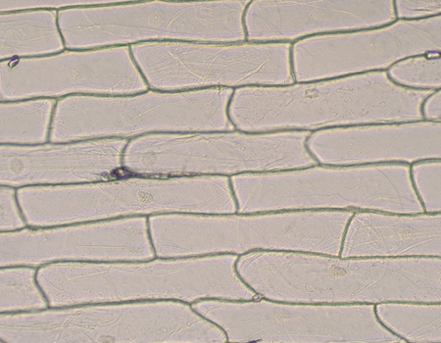
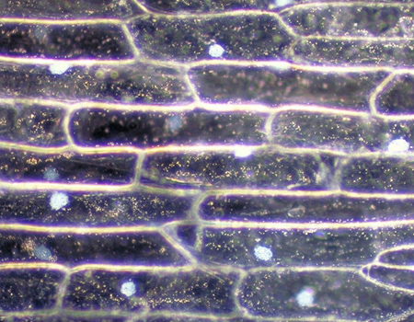
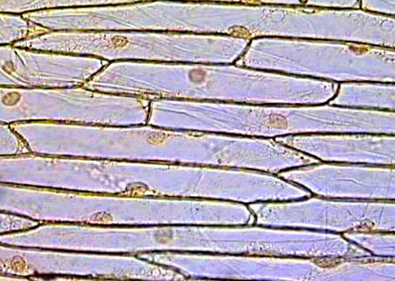
Bright Field Microscopy
With a conventional bright field microscope, we see objects in the light path because natural pigmentation or stains absorb light differentially, or because they are thick enough to absorb a significant amount of light despite being colorless.
Onion cells X50
Onion cells X50
Bright field
Bright field lighting reveals very little detail, unless a cell is stained or naturally pigmented. Cell walls and nuclei may be visible.
Dark field
Dark field illumination is excellent for viewing near-transparent specimens. The nucleus of each cell is visible.
Staining enhances contrast and reveals more detail under bright field illumination.

Slide 12
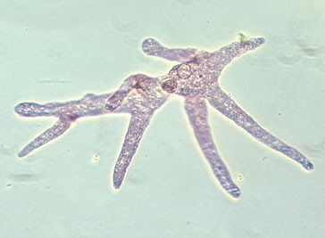
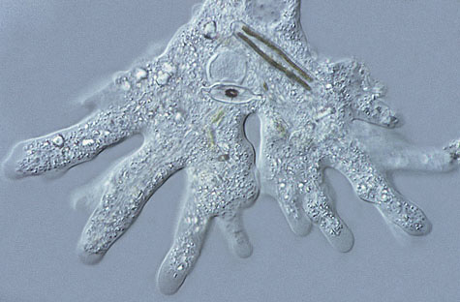
Phase Contrast Microscopy
Phase contrast microscopy is a type of light microscopy widely used for examining biological specimens. It enhances contrasts of transparent and colorless objects by influencing the optical path of light.
Differential phase contrast microscopy emphasizes edges and lines and produces a pseudo-3D effect.
Both techniques work on live specimens.
Photo courtesy Steve Durr
Amoeba
Phase contrast
Enhances contrast in unstained specimens to show structure that is difficult to see using standard bright field microscopy. It is useful for examining living, unpigmented cells.
Differential-interference contrast
Like phase contrast, DIC uses optical modifications to exaggerate differences in density within a specimen. It is often called Nomarski imaging.

Slide 13
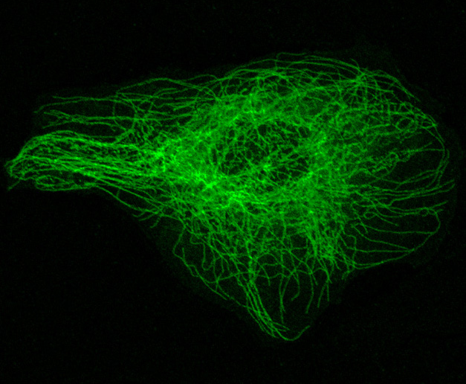
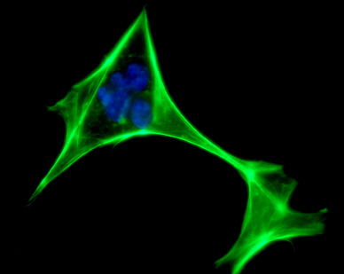
Fluorescence Microscopy
Fluorescence microscopy is used to study specimens that can be made to fluoresce. The sample can either be fluorescing in its natural form like chlorophyll and some minerals, or treated with fluorescing chemicals.
Confocal microscopy uses lasers and special optics to “optically section” a specimen so that only those regions within a narrow depth of focus are imaged. It is typically used with specimens that have been stained fluorescent.
Photo courtesy Dr Roger Wagner: University of Delaware
istock
Fluorescent microscopy
In this image of a fibroblast, an actin protein stain makes the cytoskeleton fluoresce bright green. The nucleus is blue.
Confocal microscopy
In this image, the actin stain is again used to make the cytoskeleton fluoresce, but there is clearer detail of the actin filaments.

Slide 14
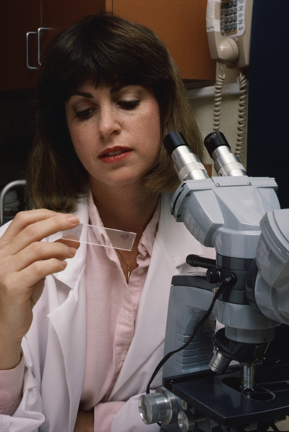
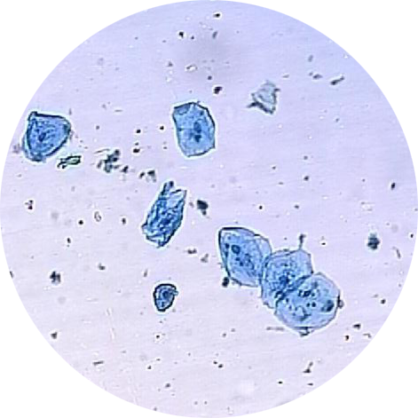
Preparing for Microscopy
For viewing under light microscopy, transparent organisms or thin sections of tissue are usually mounted on glass microscope slides and covered with a coverslip.
Temporary wet mounts can be made of fresh material and are used for immediate viewing. They can also be stained to enhance particular features.
If preparations are to be kept for any length of time, then specimens need to be specially treated (stained, fixed, and dehydrated) and then mounted permanently.
Mounts can be permanent (above)
or temporary, as shown by the stained cheek cells (inset)
X100

Slide 15
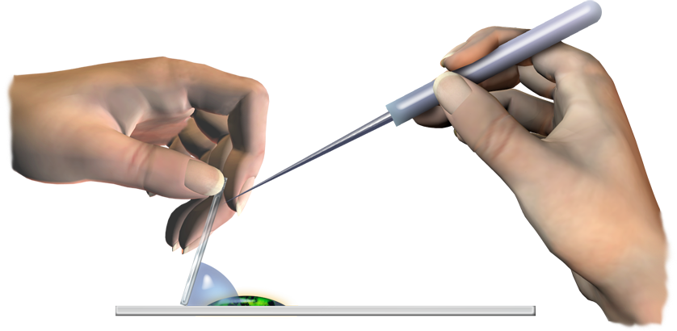
Preparing a Wet Mount
The procedure for making a temporary wet mount is simple:
  Place the specimen in the center of a clean, grease-free microscope slide.
  Cover the specimen with a drop of water or other suitable mountant such as glycerol.
  Hold a coverslip at an angle so that its bottom edge is in contact with the drop on the slide.
  Use a mounted needle to support the coverslip and lower it gently
  over the specimen. This avoids including air in the mount.
Mounted needle
Coverslip
Specimen
Mounting fluid
Glass microscope slide

Slide 16
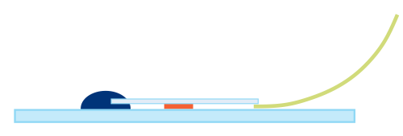

Staining a Wet Mount
Sometimes a specimen is stained to show up particular features, such as nuclei.
In vivo staining is the process of dyeing living tissues. The stains, called vital stains, are introduced to living cells, although many are eventually toxic. Examples include:
  Methylene blue: used to stain the
  nuclei of animal cells.
  Iodine: a weak solution will stain the
  starch present in plant cells black.
Vital stains can be applied before or
after the specimen is mounted.
  If a specimen is already mounted,
  a drop of stain can be placed at
  one side of the coverslip and
  drawn through using filter paper.
  Once the stain has been taken
  up by the specimen, water can
  be drawn through in the same
  way to remove excess stain.
Filter paper
Coverslip
Stain
Specimen
Specimen
The stain is drawn through the specimen

Slide 17
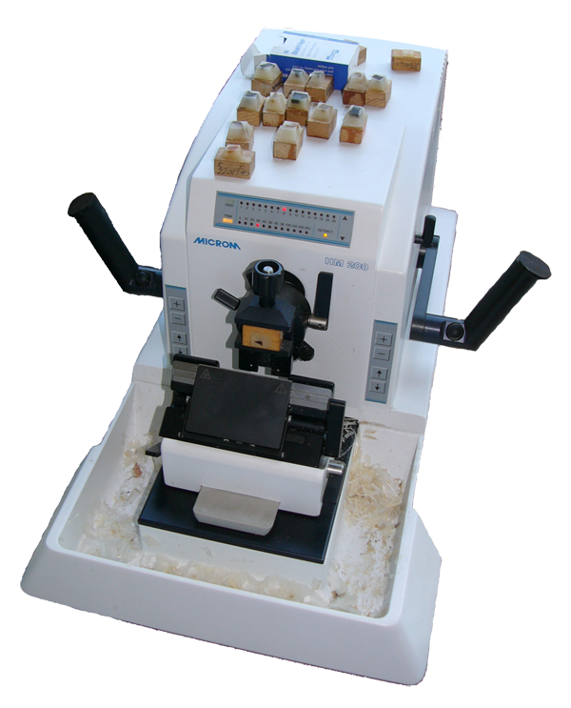
Making a Permanent Mount
Permanent mounts protect specimens during examination and allow storage without deterioration. it is a method applied to non-living specimens.
The procedure is not difficult but requires several steps, each with a specific role:
  Preserves freshly killed tissues by immersing
  them in a chemical such as formalin.
  Sectioning: Tissue may first be embedded in
  wax or plastic and sliced very thinly with a
  microtome, or sectioned with a razorblade.
  Staining: Dyes are applied that stain some
  structures while leaving others unaffected.
  Dehydration: The section is passed through
  an ethanol series of increasing concentration
  to remove the water and make it transparent.
  Clearing: A liquid such as xylol replaces the
  ethanol and ensures the material remains
  transparent.
  Mounting: The sections are mounted in a
  permanent medium (e.g. balsam).
Resin blocks containing tissue samples
An electric microtome for preparing thin sections of tissue
Wikipedia Commons; used under licence: http://creativecommons.org/licenses/by-sa/2.5/

Slide 18
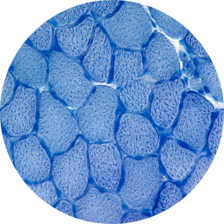
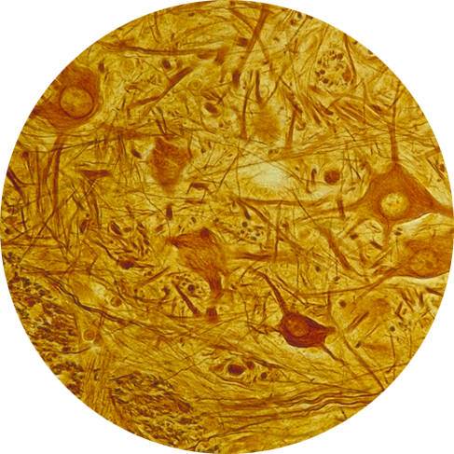
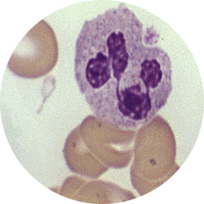
Staining for Microscopy
Stains and dyes are frequently used in biology to highlight particular features or structures in biological tissues.
Stains may be used to stain both living
cells (temporary or vital stains) or dead cells (permanent stains). Many stains are suitable for both.
Stains are useful for:
  Defining bulk tissues (e.g. muscle
  fibers or connective tissue).
  Identifying cell populations
  (e.g. blood cells).
  Viewing organelles (e.g. nuclei)
  within individual cells.
Skeletal muscle fibers stained with methylene blue
Above: Neurons from the spinal cord showing darkly stained cytoplasm (Cajal stain)
Blood smear stained with Leishman’s to show the distinctive nucleus of the leukocyte (CDC)

Slide 19
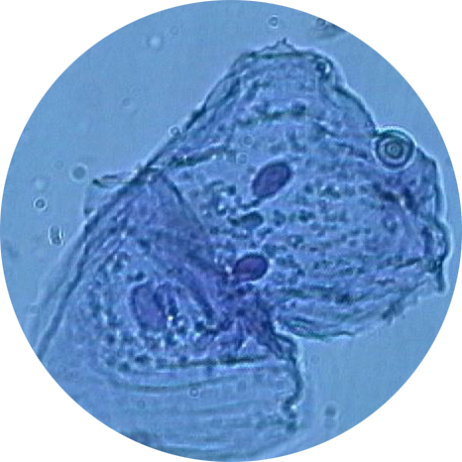
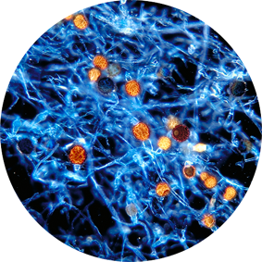
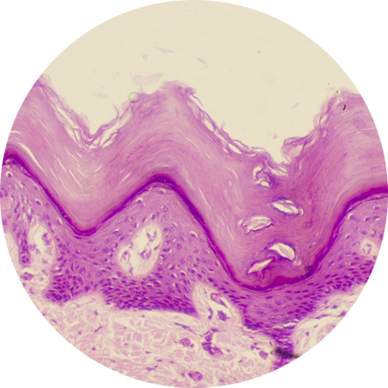
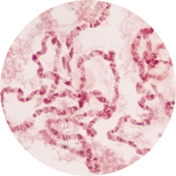
Permanent Stains
A huge range of permanent stains are used in microscopy. Many of them are used to highlight cell organelles or tissue components (e.g. collagen).
Methylene blue
(cheek cells)
Stain | Final color | Application
Methylene blue | blue | Nuclei
Safranin | red | Nuclei, suberin, and plant lignin
Aniline blue | blue | Fungal spores and hyphae
Leishman’s | red-pink blue | Red blood cells Nucleus of white blood cells
Eosin | pink/red | Cytoplasm/cellulose
Hematoxylin | blue | Nuclei of animal cells
Feulgen’s | red/purple | DNA (chromosomes in cell division)
Aniline blue
(Mucor hyphae)
Hemotoxylin & eosin (skin)
Feulgen’s stain (chromosomes)

Slide 20
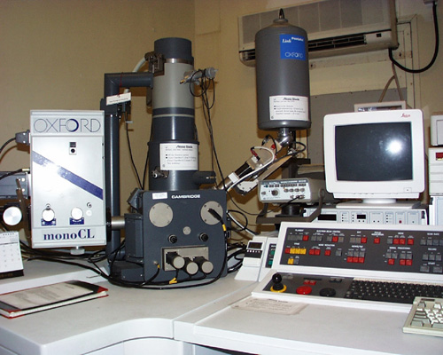
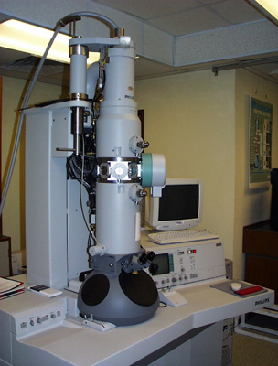
Electron Microscopes
Electron microscopes (EM) use a beam of electrons instead
of light to produce an image.
  An EM can magnify up to levels of 2 X 10⁶ times the original sample size.
  Specimens must be properly prepared for viewing and are dead.
  The higher resolution of EMs is due to the shorter wavelengths of electrons relative to light particles.
Dept of Physics: Chinese University of Hong Kong
Dept of Physics: Chinese University of Hong Kong
Scanning electron microscope
Transmission electron microscope

Slide 21
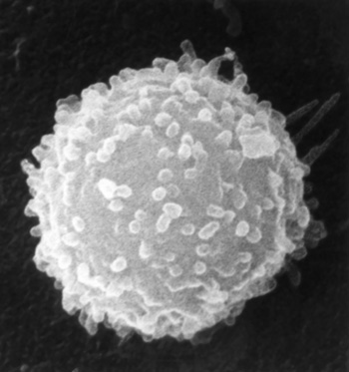
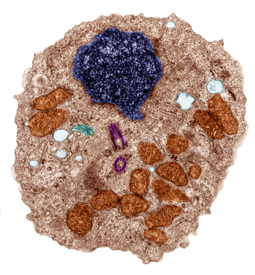

Electron Microscopes
Electron microscopes are of two basic types:
  Scanning electron microscopes.
    Electrons are bounced off the surface of an object to produce a detailed image of the external appearance.
    The image right shows a lymphocyte taken using SEM.
  Transmission electron microscopes.
    TEM is used to view extremely thin sections of material to reveal detailed images within a structure or organelle. The TEM of the ultrastructure of a lymphocyte (bottom right) reveals its internal details.
Photographs taken using electron microscopy are called electron micrographs. They are black and white unless false color is applied.
SEM lymphocyte
TEM lymphocyte (false color)

Slide 22
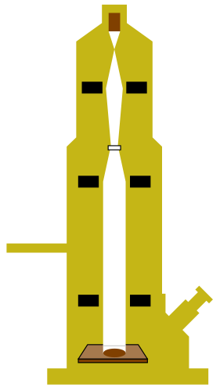
Transmission EM
Transmission electron microscopes is used to examine the ultrastructure of extremely thin sections of material.
Electrons pass through the specimen and are scattered.
Magnetic lenses focus the
image on to a fluorescent
screen or photographic plate.
Sample sections for TEM are
just 30/1000 of a millimeter thick. They are so thin that they have to be prepared with a special machine, an ultramicrotome.
TEM can magnify several hundred thousand times.
Electron gun
Electron beam
Electromagnetic condenser lens
Specimen
Electromagnetic objective lens
Electromagnetic projector lens
Vacuum pump
Eyepiece
Fluorescent screen or photographic plate
Cross section through a TEM

Slide 23
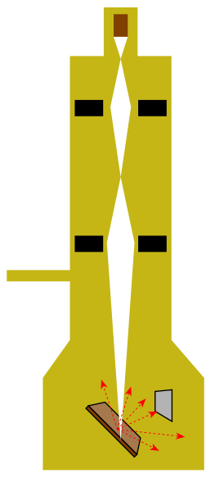
Scanning EM
A scanning electron microscope scans a sample with a beam of primary electrons.
  The primary electron beam knock electrons from the sample’s surface.
  This produces secondary electrons.
  These are picked up by a collector, amplified, and transmitted onto a viewing screen or photographic plate.
SEM produces a detailed
3-dimensional surface image
of organisms as small as bacteria and viruses.
Electron gun
Primary electron beam
Electromagnetic lenses
Vacuum pump
Electron collector
Specimen
Amplifier
Viewing screen
Secondary electrons
Cross section through an SEM

Slide 24
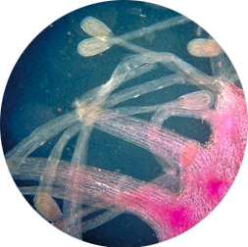
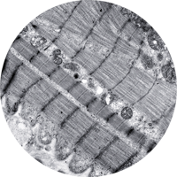
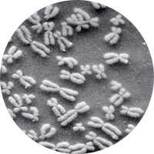
Microscopes Compared
Key differences between TEM, SEM, and light microscopy are outlined below:
 | Light microscope | TEM | SEM
Radiation source | light | electrons | electrons
Wavelength | 400-700 nm | 0.005 nm | 0.005 nm
Lenses | glass | electromagnetic | electromagnetic
Specimen | living or non-living supported on glass slide | non-living supported on a small copper grid in a vacuum | non-living supported on a metal disc within a vacuum
Maximum resolution | 200 nm | 1 nm | 10 nm
Maximum magnification | 1500 x | 250 000 x | 100 000 x
Stains | colored dyes | impregnated with heavy metals | coated with carbon or gold
Type of image | may be colored | monochrome | monochrome

Slide 25
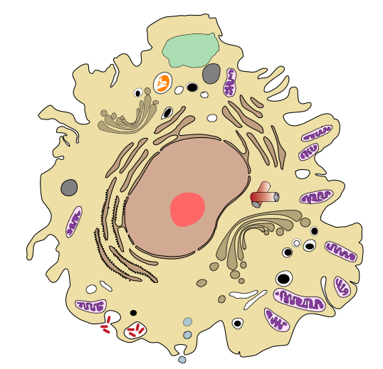
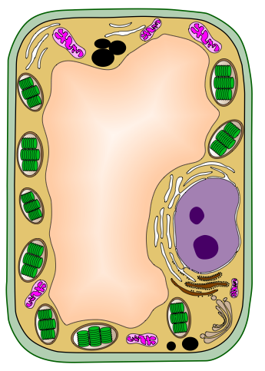
Animal & Plant Cells
Animal and plant cells have many organelles in common, as well as several features specific to each. Specialized features of each are labelled on the diagrams of a animal cell and an plant cell below.
Lysosome
Chloroplast
Centrioles
Cell wall
Starch granule
Animal Cell
Plant Cell

Slide 26
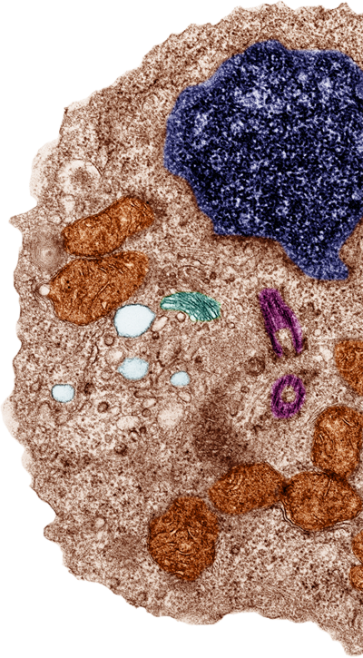
Features Shared by Plant and Animal Cells
Some cellular organelles are commonly found in both plant and animal cells, while others are found exclusively in just one or the other cell type.
Organelles and structures common to
both plant and animal cells include:
  nucleus
  plasma membrane
  ribosomes
  mitochondria
  Golgi apparatus
  endoplasmic reticulum (rough and smooth)
  cytoskeleton
  vacuoles and vesicles, although these differ
  in size and function in plants and animal cells.

Slide 27
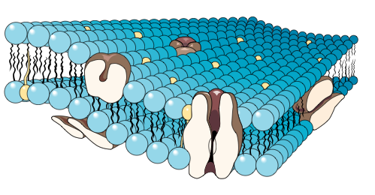
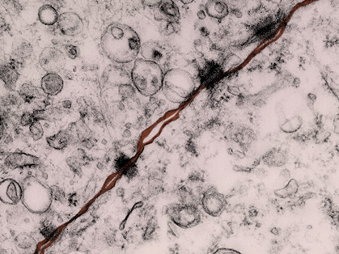
Plasma Membrane
Located:
Surrounds the cell forming a
boundary between the cell contents
and the extracellular environment.
Structure:
Semi-fluid phospholipid bilayer in which proteins are embedded. Some of the proteins fully span the membrane.
Function:
  Forms the boundary between the cell and the extracellular environment.
  Regulates movement of substances in and out of the cell.
Size: 3–10 nm thick.
Phospholipid bilayer
Protein
The plasma membranes of two adjacent cells joined with desmosomes

Slide 28

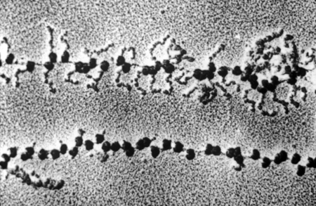
Ribosomes
Small subunit
Located:
Free in the cytoplasm or bound to rough endoplasmic reticulum.
Structure:
Made up of ribosomal RNA and protein and composed of two subunits, a larger and a smaller one.
Function:
Synthesis of polypeptides
(proteins).
Size: 20 nm.
Large subunit
Polypeptide chain
Ribosomes
Polypeptides being produced on a polyribosome system

Slide 29
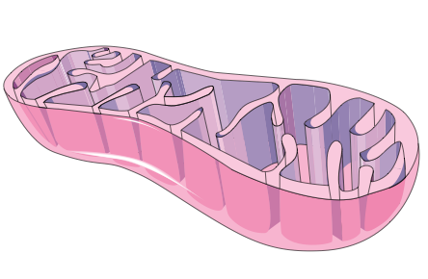

Mitochondria
Folded inner membrane forms cristae
Located:
Cytoplasm
Structure:
Rod shaped or cylindrical
organelles occurring in large numbers, especially in metabolically very active cells. Bounded by a double membrane; the inner layer is extensively folded to form partitions called cristae. Mitochondria contain some DNA.
Function:
The site of cellular respiration (the production of ATP).
Size: Variable but 0.5–1.5 µm wide and 3.0–10 µm long.
Smooth outer membrane
Matrix
A single mitochondrion in cross section

Slide 30


Rough Endoplasmic Reticulum
Membranous tubules
Located:
Continuous with the nuclear membrane and extending to the cytoplasm as part of the endomembrane system.
Structure:
A complex system of membranous tubules studded with ribosomes. Connected to the smooth ER but structurally and functionally distinct from it.
Function:
  Synthesis, folding, and
  modification of proteins.
  Transport of proteins through the cell.
  Membrane production.
Size: Variable according to cell size.
Ribosome
Transport vesicle budding off

Slide 31


Smooth Endoplasmic Reticulum
Membranous tubules lacking ribosomes
Located:
In the cytoplasm as part of the endomembrane system.
Structure:
A system of membranous tubules
similar in appearance to the rough ER but lacking ribosomes.
Function:
  Synthesis of lipids, including oils, phospholipids, and steroids.
  Carbohydrate metabolism.
  Transport of these materials through the cell.
  Detoxification of drugs and poisons.
Size: Variable according to cell size.
Transport vesicle budding off

Slide 32


Golgi Apparatus
Transfer vesicle from the ER
Located:
Cytoplasm, associated with the ER.
Structure:
Stack of flattened, membranous
sacs called cisternae.
Function:
  Modification of proteins and lipids received from the ER.
  Sorting, packaging, and storage of proteins and lipids.
  Transport of these materials in vesicles through the cell.
  Manufacture of some certain macromolecules, e.g. hyaluronic acid.
Size: 1-3 µm diameter
Also called: Golgi, Golgi body
Cisternae
Vesicle from the ‘shipping’ side of the Golgi

Slide 33

Nucleus
Located:
Variable location; not necessarily near the center of the cell.
Structure:
Surrounded by a nuclear envelope and encloses the genetic material (chromatin). Nuclear envelope comprises a double membrane perforated by pores ~100 nm in diameter. The two membranes are separated by a space of ~20-40 nm.
Function:
Contains most of the cell’s genetic material, which regulates all the
activities of the cell.
Size: 5 µm diameter.
Nuclear pores
Nuclear membrane
Nucleolus
Chromatin

Slide 34

Nucleolus
Located:
Within the nucleus.
Depending on the organism, there may be more than one.
Structure:
A prominent structure which appears under EM as a mass of darkly stained granules and fibers adjoining part of the chromatin.
Function:
  Synthesis of ribosomal RNA
  Assembly of ribosomal subunits.
Size: 1-2 µm diameter.
Nucleolus

Slide 35


Centrioles
Microtubules
Located:
In the cytoplasm, as part of the cell cytoskeleton. Usually next to or close to the nucleus.
Structure:
Found as a pair, each one composed of nine sets of triplet microtubules arranged in a ring.
Function:
Involved in organizing microtubule assembly (spindle formation) but not essential as they are absent from the cells of higher plants.
Size: 0.25 µm diameter.
Centriole in cross section

Slide 36


Vacuoles and Vesicles
Located:
In the cytoplasm; often numerous.
Structure:
Vacuoles and vesicles are both membrane-bound sacs, but vacuoles are larger.
Function:
  food vacuoles in animal cells are formed by phagocytosis of food particles.
  contractile vacuoles of freshwater protists pump excess water from the cell.
  central vacuole of plants provides cell volume and stores inorganic ions and metabolic wastes.
Size: varies according to
cell type and size.
Food vacuole in a human lymphocyte

Slide 37

The Cell Cytoskeleton
Located:
A network throughout the cytoplasm.
Structure:
A dynamic system of microtubules, microfilaments, and intermediate filaments.
Function:
  shape and mechanical support for the cell
  regulation of cellular activities, e.g. guiding secretory vesicles.
  especially important in animal cells.
  involved in cell movement (motility).
Size:
  microtubules: 25 nm
  microfilaments (actin filaments): 7 nm
  intermediate filaments: 8-12 nm
An actin stain reveals the cytoskeleton of a fibroblast
iStock

Slide 38
The Cell Cytoskeleton
Plasma membrane
Intermediate filament
An organelle held in place by cytoskeleton
Microtubule
Microfilament

Slide 39

Specialist Plant Cell Features
A small number of cellular organelles are typically found in plant cells but not in animal cells.
Organelles and structures found in plant cells are:
  cellulose cell wall
  plastids
    chloroplasts
    amyloplasts
    chromoplasts
iStock
Cross section through a buttercup stem showing the individual cells

Slide 40


Chloroplasts
Located:
Within the cytoplasm of plant leaf
(and sometimes stem) cells.
Structure:
  Specialized plastids containing the green pigment chlorophyll.
  Two outer membranes are separated by a narrow inter-membrane space.
  Inside the chloroplasts are stacks of flattened sacs or thylakoids which are stacked together as grana.
  Chloroplasts contain some DNA
Function:
The site of photosynthesis
Size: 2 X 5 µm.
Grana
Stroma

Slide 41

Cellulose Cell Wall
Located:
Surrounds the plant cell and lies outside the plasma membrane.
Structure:
Cellulose fibers, with associated hemicelluloses (branched polysaccharides) and pectins. Between the walls of adjacent cells, is a sticky substance called the middle lamella.
Function:
  protects the cell
  maintains cell shape
  prevents excessive water uptake
Size: 0.1 µm to several µm thick.
Middle lamella
Pectins
Hemicelluloses
Cellulose fibers
Diagrammatic representation of plant cell wall structure

Slide 42


Plastids
Located:
In the cytoplasm.
Structure:
Double membrane-bound structures.
The inner membranes typically possess the enzymes that determine what plastids do.
Function:
Different plastids have particular roles:
  Chloroplasts; site of photosynthesis
  Chromoplasts: contain red, orange,
  and/or yellow pigments and give color to plant organs such as flowers and fruits. They serve as attractants and identifiers.
  Amyloplasts: storage of starch and fats.
Size: variable depending on type
Colorless amyloplasts in potato tubers
Chromoplasts provide the bright color of flowers and fruit

Slide 43


Intercellular Connections in Plant Cells
The cells of a plant or animal are organized into tissues, organs, and organ systems.
Neighboring cells often interact, adhere, and communicate through special regions of direct physical contact.
In plant cells these connections
are called plasmodesmata.
  Plant cell walls are perforated with channels or plasmodesmata.
  Cytosol passes through the plasmodesmata and connects the living contents of adjacent cells.

Slide 44
Specialist Animal Cell Features
A small number of cellular organelles are typically found in animal cells but not in plant cells.
Organelles and structures found in animal cells are:
  lysosomes
  cilia
  flagella
TEM of a human lymphocyte

Slide 45


Lysosomes
Membrane proteins
Located:
Free in the cytoplasm.
Structure:
Single-membrane-bound sac of hydrolytic enzymes. Lysosomes bud off the Golgi apparatus.
Function:
  intracellular digestion of macromolecules (fats, protein, polysaccharides, and nucleic acids)
  recycling of cellular components (autophagy)
  low internal pH maintained by H⁺ pump in the lysosomal membrane
Size: varies according to cell size
Hydrolytic enzymes break down compounds by adding water
Lysosomes in a lymphocyte. Note how they are budding from the Golgi

Slide 46


Cilia and Flagella
2 central single microtubules
Located:
Anchored to the cell membrane of some animal cells and unicellular eukaryotes.
Structure:
Core of microtubules sheathed in an extension of the plasma membrane. Microtubules are arranged in a 9+2 pattern with nine doublets of microtubules arranged in a ring
around two single microtubules.
Function:
Cell motility or, in cells held in place, they move fluid across the cell surface.
Size:
  Cilia: 0.25 µm X 2-20 µm
  Flagella: 0.25 µm X 10-200 µm
9 doublets of microtubules
Plasma membrane extension
Basal body
anchors the cilium
TEM of cilia in cross section

Slide 47
Intercellular Connections in Animal Cells
Desmosomes (anchoring junctions)
  Act as rivets, fastening cells together
  into strong sheets.
Gap junctions (communicating junctions)
  Cytoplasmic channels between
  adjacent cells.
  Each pore is surrounded by special membrane proteins.
  Pores allow passage of small molecules such as salt ions, sugars, and amino acids.
Tight junctions of animal cells.
  Membranes of neighboring cells are fused.
  Prevent leakage of extracellular fluid across a layer of epithelial cells.
The plasma membranes of two adjacent cells joined with desmosomes

Slide 48

Intercellular Connections in Animal Cells
Tight junction: The fusion of adjacent cell membranes prevent leakage of extracellular fluid. Tight junctions form a continuous belt around cells.
Desmosome:
An anchoring junction fastens cells into sheets. Desmosomes are strengthened by keratin protein filaments.
Gap junction:
A communicating junction provides a narrow channel between neighboring cells.
Extracellular matrix

Slide 49


Viruses
Viruses were first identified in the late 1800s with the discovery that tobacco mosaic disease was caused by a virus.
Viruses are pathogens which cause disease in plants, animals, and bacteria.
Viruses that kill bacteria are called bacteriophages or phages.
Viruses are non-cellular. There is debate about whether they can be classed as living organisms because they do conform to the existing criteria on which a five or six kingdom classification system is based.
Viruses are obligate intracellular parasites, they are incapable of metabolism or reproduction without
utilizing a host cell.
Tobacco mosaic virus
CDC
Small pox, caused by the Variola virus

Slide 50


Viral Structure
Tobacco Mosaic Virus
Retrovirus (HIV)
RNA
Glycoprotein spikes of viral envelope
RNA
Capsomere
Capsid
Reverse transcriptase
50 nm
Protein capsid; there is no plasma membrane
Viruses take on many forms, but the key structural components are evident in all morphologies. The tobacco mosaic virus (above left) and HIV retrovirus (above right) demonstrate the main features of viruses: a protein coat or capsid surrounding the viral genetic material and enzyme (if present).

Slide 51



Viral Morphology
Viruses can be distinguished and classified in two main ways.
  Their format of their genetic material (e.g. DNA or RNA)
  Their morphology (shape) which generally takes on one of three forms:
Polyhedral
Rod
Tail fibers
Helical (they may be rod shaped), e.g. Ebola or tobacco mosiac virus
Polyhedral: capsid appears spherical, e.g. adenovirus, first isolated from human adenoids.
Complex (a mix of polyhedral and helical), e.g. T4 bacteriophage.

Slide 52


A New View on Viruses
The identification in 2004 of a new family of viruses, called mimiviruses, prompted a rethink of the previously conservative view of viruses.
Mimivirus is a very large virus
(400 - 800 nm) found in certain species of amoebas.
Mimivirus contains over 1000 genes; their existence suggests a fourth domain of life.
The lineage for mimiviruses is
thought to be very old.
  It has opened debate about whether they existed prior to cellular organisms.
Core
• ds DNA
• 90% coding capacity
• 10% ‘junk’
• 1.2 million base pairs
• ~911 genes for protein
• additional genes
Capsid
400 nm
Fibrils
Acanthamoeba polyphaga mimivirus

Slide 53


Bacterial Cells
Bacterial cells are prokaryotic cells.
  They lack many eukaryotic features (e.g. a distinct nucleus and membrane-bound cellular organelles).
The bacterial cell wall is a prominent feature of bacterial cells.
  It is a complex, multi-layered structure and often has a role in conferring virulence on a bacterial strain.
A
CDC
A. Bacillus cereus grown on a blood agar plate.
B. cereus produces a toxin which causes vomiting or diarrhea when toxin levels are sufficiently high.
B. SEM of Salmonella typhimurium bacteria invading cultured human cells. Salmonella is a common cause of gastroenteritis amongst humans.
Rocky Mountain Laboratories, NIAID, NIH
B

Slide 54




Bacterial Cells
Photo: NY State Department of Health
Gram positive cocci
Escherischia coli
Campylobacter
Bacteria are very diverse in morphology and metabolism. The generalized diagram of a bacterial cell above is useful for demonstrating the key components of bacterial cells.

Slide 55
Cell Wall
A complex, semi-rigid structure that gives the cell shape, prevents rupture, and serves as an anchorage point for flagella.
The cell wall is composed of a macromolecule called peptidoglycan; repeating disaccharides attached by polypeptides to form a lattice.
The wall also contains varying amounts of lipopolysaccharides and lipoproteins.
The amount of peptidoglycan present in the wall forms the basis of the diagnostic gram stain.
In many species, the cell wall contributes to virulence (disease-causing ability).

Slide 56

Cell Membrane
The plasma membrane is similar in composition to eukaryotic membranes, although less rigid.
Bacteria lack membrane-bound organelles, so in some bacteria the plasma membrane becomes invaginated to form a specialized membranous structure (e.g. for cellular respiration).
Bacillus megaterium, clearly showing the plasma membrane (dark blue). Note the thick cell wall (brown) surrounding the entire cell.

Slide 57


Glycocalyx
The glycocalyx is a viscous, gelatinous layer outside the cell wall composed of polysaccharide and/or polypeptide.
  If firmly attached to the wall, it is a capsule.
  If loosely attached, it is a slime layer.
Capsules contribute to virulence in pathogenic species, e.g. Bacillus anthracis, by protecting the bacteria from the host’s immune system.
In some species, the glycocalyx enables attachment to substrates.
Far left:
The capsule of Bacillus anthracis (the cause of anthrax) is revealed with an Indian ink stain.
Left: Heavily encapsulated strains form slimy colonies on agar.
Photos CDC

Slide 58

Flagella
Some bacteria have long, filamentous appendages, called flagella, that are used
for locomotion.
Flagella may be variously arranged:
  A single polar flagellum = monotrichous
  One or more flagella at cell ends = polar
  Distributed over the entire cell = peritrichous
Vibrio vulnificus is a flagellated bacterium found in warm ocean environments.
(SEM X 26,000).
CDC

Slide 59

Fimbriae
Fimbriae are hair-like structures that form a fringe around some bacteria.
  Fimbriae are shorter, straighter, and thinner than flagella.
  Fimbriae are used for attachment to other cells. They are not used for movement.
Pili are similar to fimbriae, but are longer and less numerous.
  They are involved in bacterial conjugation and as phage receptors.
Escherichia coli
bacterium (right) with a fringe of fimbriae (false color SEM). In this case, the fimbriae aid attachment to the intestinal wall.

Slide 60

Chromosomes
Bacterial DNA is organized in a single circular strand. This makes them haploid for most genes.
Bacteria cells lack a nuclear membrane so their DNA is located within the cytoplasm in an area called the nucleoid.
Some genes are found on both plasmids
and on the chromosome.
It is possible for free ribosomes to attach to mRNA while the mRNA is still in the process of being transcribed from the DNA.
In this TEM of bacterial cells, the nuclear region appears as a lighter central zone called the nucleoid.

Slide 61

Plasmids
Bacterial plasmids are small, circular DNA molecules (accessory chromosomes) which can reproduce independently of the main chromosome.
There may be more than one per cell; a group of plasmids may contain several copies of a gene.
Plasmids can move between cells, and even between species, by conjugation.
  This property accounts
  for the transmission of
  antibiotic resistance
  between bacteria.
Plasmids are also used as
vectors to carrying specific
DNA sequences in
recombinant DNA technology.

Slide 62



Bacterial Cell Shapes
Most bacterial cells range between 0.20-2.0 µm in diameter and 2-10 µm length.
In terms of gross morphology (appearance), there are several basic shapes:
  Bacilli: rod shaped
  Cocci: spherical
  Spirilla: spiral or corkscrew shaped
  Vibrio: comma shaped curved rods
USDA
Escherichia coli
Staphyloccus aureus
Borrelia burgdorferi

Slide 63


Bacterial Morphology:
Bacilli
Graphical representation of bacilli bacteria.
Rod-shaped bacteria that divide only across their short axis.
Most occur as single rods, although pairs and chains are also found.
The term bacillus can refer to the shape, but it may also denote a genus.
Escherichia coli (above) is an example of a bacillus bacterium commonly found in the human gut. Certain strains can cause illness such as pneumonia, mastitis or meningitis.

Slide 64


Bacterial Morphology:
Cocci
Cocci are usually round, but may also be somewhat oval or elongated.
When they divide, the cells stay attached to each other and remain in aggregates that are usually a feature of the genus.
  Pairs are called diplococci.
  Clusters are called staphylococci.
Graphical representation of diplococci bacteria (left).
USDA
Staphylococcus aureus (X 50,000).
Note their spherical shape.

Slide 65


Bacterial Morphology:
Spirilla & Vibrio
Graphical representation of a spirillum bacterium.
These are bacteria with one or more twists.
Spirilla bacteria have a helical (corkscrew) shape which may be rigid or flexible (as in spirochetes).
Vibrio bacteria look like curved rods (comma shaped).
Vibrio vulnificus cells exhibit the classic comma shaped morphology of vibrio bacteria.
False color SEM X13,184
CDC

Slide 66

Bacterial Conjugation
Conjugation describes the transfer of genetic material between bacterial cells.
It is 'pseudo sex', in which there is a one-way exchange of genetic information from two temporarily joined cells.
The genetic material is transferred as a plasmid (a small circular DNA molecule that is separate from the bacterial chromosome).
The conjugative plasmid passes through a tube called a sex pilus to the other cell.
Sex pilus
Two E.coli bacteria undergoing conjugation. TEM X5000.

Slide 67

Bacterial Conjugation
Pili, which are longer than fimbriae, join bacterial cells together to conduct DNA between them.
Recipient bacterium
Non-conjugative plasmid.
Conjugative plasmid
Sex pilus (pl. pili)
There are only one or two pilli per cell. They are similar to fimbriae but longer and less numerous. As well as their role in conugation, they can act as phage receptors.
Donor bacterium
Plasmid about to pass one strand of the DNA into the sex pillis.

Slide 68


Gram Staining
The Gram stain is an important microbiological identification tool.
The gram stain differentiates bacteria into two major categories:
  Gram positive cells
  Gram negative cells
The chemical and physical properties of a bacterial cell wall determine the staining response.
CDC
CDC
Here, crystal violet stain is applied to the specimen in the first step of gram staining.
The cell walls of gram positive bacteria, such as Bacillus anthracis (above) retain the stain

Slide 69
The Gram Staining Method
Staining step | Gram positive bacteria | Gram negative bacteria
Specimen fixation
Primary stain: crystal violet
Mordant: Iodine solution
Decolorization: ethanol
Counter stain: safranin
The major steps of the gram staining technique are outlined above. At each staining step, the reactions of gram positive and gram negative bacteria are given.

Slide 70

Gram Positive Bacteria
Gram positive bacteria appear blue-black or purple using the gram stain.
Gram positive cell walls contain large amounts of peptidoglycan.
The peptidoglycan retains the crystal violet stain after the decolorization step.
Bacillus anthracis is a gram positive bacteria responsible for anthrax. In this sample of cerebral spinal fluid (left) the gram positive Bacillus anthracis show up as purple rods.
Photo: US Department of Health and Human Services

Slide 71

Gram Negative Bacteria
Gram negative bacteria have a more complex cell wall structure than gram positive bacteria, with higher proportions of lipoprotein and lipopolysaccharide and less peptidoglycan.
Because of the thin peptidoglycan layer, the stain is easily removed by the decolorization step.
Gram negative bacteria appear red or pink after gram staining because they take up the pink safranin counter-stain.
Pseudomonas aeruginosa (left) is an example of a gram negative bacterium. It is a common human pathogen, and can cause a host of illnesses including respiratory infections, dermatitis, and gastroenteritis.
CDC

Slide 72



Protists
The protists are a diverse group and not a natural (monophyletic) group. Essentially, they include the organisms that cannot be classified into any other kingdom.
The protists vary in size and appearance; from plant-like algae, to animal-like protozoans, and fungus-like slime molds.
They exhibit features typical of generalized eukaryotic cells, but also have specialized features.
Protists are found almost anywhere there is water.
Some protists are found within larger organisms (as parasites or symbionts).
A
B
Protozoans are the animal-like protists. They include:
A. Radiolarians, ocean holoplankton.
B. Paramecium, a freshwater ciliate.
C. Stentor roeseli, a freshwater ciliate.
C

Slide 73

Euglenoid Flagellates
Euglenoid flagellates, such as Euglena, are found in freshwater environments.
Euglena is autotrophic and are capable of photosynthesis, but are also capable of heterotrophy when deprived of light.
All lack a cell wall. The body is covered by a tough, proteinaceous pellicle.
One, or sometimes two,
long, conspicuous flagella,
which are used in locomotion.
Size: 130 x 50 µm.
Eye spot:
involved in light detection
Flagellum beats for movement
Nucleus
Chloroplast
Gullet
Second, very small, flagellum
Pellicle: A tough, flexible protein layer supporting the plasma membrane that allows the cell to change its shape.
Paramylon granules
store starch-like energy reserves
Contractile vacuole:
regulates water balance.
Euglena (130 X 50 µm)

Slide 74

Chlamydomonas
Chlamydomonas is a photosynthetic green alga.
Its habitat is fresh water.
Movement is achieved by the action of two flagella.
Size: 20 x 10 µm.
Chloroplast
Pyrenoid: the region of starch formation.
Nucleus
Cell wall: composed of cellulose.
Contractile vacuole:
regulates water balance.
Cytoplasm
Flagella for movement.
Eye spot:
involved in light detection.

Slide 75

Amoeba
Amoeba is a genus of protozoa characterized by pseudopods used for movement.
The naked amoebas and the foraminferans belong to a group of animal-like protistans called rhizopods.
Amoeboids are heterotrophic, ingesting food and accumulating it inside a vacuole.
Amoeba are found in freshwater environments, and many moist habitats including soil. Some are pathogenic.
Size: 800 x 400 µm.
Contractile vacuole:
involved in water regulation.
Nucleus
Food vacuole: contains ingested food
Pseudopod:
flowing projections of cytoplasm allow movement and enable food to be engulfed by phagocytosis.
Food is ingested by phagocytosis

Slide 76


Paramecium
Paramecium is a genus of ciliated protozoans.
They are characterized by their external covering of hair-like cilia.
Cilia are structures for motility, and they continuously beat to enable movement.
Paramecium are heterotrophic, and ingest food via an oral groove.
Paramecium are found in freshwater and marine environments.
Size: 240 x 80 µm.
Food vacuoles:
contain ingested food.
Contractile vacuole
Oral groove:
lined with cilia to help move the food into the base of the oral groove.
Cilia: hair-like structures for movement
Food
Nuclei: two types which carry out different functions.
Anal pore: undigested contents of food vacuoles are released when they fuse with the cell membrane

Slide 77


Fungi
The fungi is a large kingdom of eukaryotic organisms which includes the yeasts, molds, and fleshy fungi.
Fungi can be unicellular or multicellular.
Fungi have valuable economic roles in industry and
are important as decomposers in food chains.
All fungi are heterotrophic. For survival, they need:
  a source of nitrogen
  an organic carbon source such as cellulose
  growth factors such as vitamins
  some ions, e.g. magnesium and phosphorus
  temperature between 5°C and 25°C
  Water
  Oxygen (few are anaerobic)
  neutral to slightly acid pH

Slide 78

Fungal Nutrition
Fungi acquire the nutrients they need by absorption.
A fungus secretes enzymes from the hyphal tip on to its food source, and its digestion is extracellular (takes place outside of the fungal body).
Released nutrients are absorbed by the hyphae across the chitinous cell wall and plasma membrane and transported to all parts of the fungal body.
Hypha
Vacuole
Cell wall
Sugars
Fatty acids
Glycerol
Amino acids
Enzymes secreted to digest complex carbohydrates, proteins, and fats in the substrate.
Products absorbed

Slide 79

Symbiotic Fungi
Most (>95%) vascular plants have a symbiotic relationship with fungi. The symbiotic structure they form is called a mycorrhiza.
  In these relationships, the plants roots and fungi associate in a mutualistic relationship.
  The fungi increase the absorptive surface of the plant root system, and the plant exchanges nutrients with the fungi.
The black truffle (right) is the result of a mycorrhizal association between a tree (often an oak) and the fungal genus Tuber.
A lichen is a symbiotic relationship between a photosynthetic microorganism (usually cyanobacteria or a green algae) and a fungus.
The black truffle (above) is an example of an edible mycorrhiza. Black truffles are highly prized as a culinary delicacy, and are very expensive to purchase. Truffles are grown commercially by inoculating tree roots with the truffle fungus.

Slide 80

Economic Roles of Fungi
Fungi play an important economic role in industry and medicine.
Some members of the fungal genus Pencillium produce the antibiotic penicillin, which is used to treat a wide variety of bacterial infections.
Other Penicillium species (Penicillium camemberti) ferment soft cheeses such as brie or camembert.
Yeasts are widely used in baking bread and the fermentation of alcoholic beverages.
Penicillium notatum is also called bread mold. It produces the antibiotic penicillin. (SEM X1200)

Slide 81



Fungal Lifestyles
Fungi obtain nutrients in one of three ways:
  Saprobes: nutrients are absorbed from the extracellular digestion of non-living organic materials, e.g. logs, dead plant material.
  Parasites: nutrients are absorbed from the cells of a living host. There is no benefit to the host, e.g. the group of fungi that cause ringworm.
  Mutualistic symbiont: nutrients are absorbed from a living organism. The host is unharmed, and there is benefit to both parties, e.g. lichens.
CDC
Parasite: Ringworm (tinea) is caused by a genus of parasitic fungi. The example here on the arm is tinea corporis.
Saprobes
Mutualistic symbiont

Slide 82

Single Celled Fungi
Yeasts are an example of a single celled fungi.
They are nonfilamentous, and typically oval or spherical in shape.
Reproduction is by fission or budding.
Yeasts are facultative
anaerobes, and used in
the brewing, wine making
and baking industries.
Storage granule
Budding cell
Rough endoplasmic reticulum
Nucleus
Nucleolus
Nuclear pore
Golgi apparatus
Vacuole
Parent cell
Mitochondria

Slide 83



Filamentous Fungi
Molds are multicellular, filamentous fungi.
They are often divided by septa into uni-nucleate, cell-like units.
When conditions are favorable, hyphae grow to form a filamentous mass called a mycelium.
Some species have hyphae divided by crosswalls (septa)
Rough endoplasmic reticulum
Nucleus
Vesicles
Vacuole
Rigid, chitinous cell wall
Mitochondrion
Golgi apparatus
Fungal mycelium

Slide 84

Fungal Reproduction
Many fungi can reproduce both sexually or asexually.
A typical reproductive cycle for a filamentous fungus, Rhizopus, is shown below.
Zygospore forms
Aerial hypha produces a sporangium containing asexual spores (N)
Zygospore produces a sporangium
Gamete
Conjugation
No conjugation
Spores are released in favorable conditions
Hypha
Sporangium releases spores
Gametes form
Sexual cycle
Asexual cycle
Spores germinate producing hyphae
Spores germinate producing hyphae

Slide 85

Cell
Fractionation
Cell homogenate
Differential centrifugation is also called cell fractionation. It is a widely used tool which enables the extraction of organelles from cells.
The aim is to isolate and identify cellular fractions (organelles of a particular type) from a heterogeneous (mixed) sample.
Isolating organelles in this way has allowed their structure and function to be explored.
During cell fractionation, samples are:
  kept cold to prevent self digestion
  kept in a buffered isotonic solution to prevent changes in volume and enzyme denaturation.
  spun down at increasing centrifugation
  speeds (steps 1-4)
1
Pellet contains:
whole cells
nuclei
cytoskeletons
2
Pellet contains:
Mitochondria
lysosomes
peroxisomes
3
Pellet contains:
small vesicles
4
Pellet contains:
ribosomes
viruses
large macromolecules

Slide 86




Cell Fractionation
1
The sample is chilled over ice and cut into small pieces in a cold, buffered, isotonic solution.
2
The sample is homogenized by breaking down the cells’ outer membranes. The cell organelles remain intact.
3
The homogenized suspension is filtered to remove cellular debris. It is kept cool throughout.
4
The filtrate is centrifuged at low speed to remove partly opened cells and small pieces of debris.

Slide 87




Cell Fractionation
5
The supernatant containing the organelles is carefully decanted off.
6
The sample is centrifuged at 500-600 g for 5-10 minutes then decanted.
7
The sample is centrifuged at 10,000-20,000 g for 15-20 minutes and then decanted.
8
The sample is centrifuged at 100,000 g for 1 hour and decanted.

Slide 88


Slide 89
Terms of Use
Biozone International retains copyright to the intellectual property included in this presentation file, with acknowledgement that certain photos are used under license and are credited appropriately on the next screen.
You MAY:
  Use these slides for presentations in your classrooms using a data projector, interactive whiteboard, and overhead projector.
  Place these files on the school’s intranet (school computer network), but not in contradiction of clause 3 (a) below.
  Edit and customize this file by adding, deleting, and modifying information to better suit your needs.
  Place these presentation files on any computer within the school, including staff laptops.
  Print out this file in PowerPoint “Handouts” format as per the print dialogue box, for the express purpose of allowing students to make their own notes about the presentation.
You MAY NOT:
  Put these presentation files onto the internet or on a service that may be accessed offsite from the campus, unless access to the service is protected by a user login and password protocol.
  Print these files onto paper to make your own worksheets for distribution to students.
  Create a NEW document using any of the graphics/images in this presentation file.
  Incorporate any part of this presentation file for the production of another commercial product.
  REMOVE any of the references to Biozone, the copyright notices, photo credits, or terms of use from this file.

Slide 90
Photo Credits
Images Used Under Licence
Photographic images are used under licence from the following photo libraries:
  Corel Corporation Professional Photos
  (various titles, including: Science & Medicine, Agriculture).
  ArtToday.com
  Clipart.com
  PhotoDisc Inc.
  Hemera Technologies Inc.
  PhotoObjects.com
  Visuals Unlimited
  iStock
  Education Interactive Imaging
Images Used with Permission
Photographic images used with permission from the copyright holder:
Steve Durr; University College of London
Robert Wagner; University of Delaware
Michal Manas wikipedia commons: under licence:
http://creativecommons.org/licenses/by-sa/2.5/
Images from the Public Domain
Images from the public domain include copyright expired, uncopyrighted, or uncopyrightable material:
CDC Public Health Image Library (PHIL)
US Department of Agriculture
Rocky Mountain Laboratories, NIAID, NIH
NY State Department of Health
US Department of Health and Human Services
Additional artwork and photographs are the property of Biozone International Ltd.
BIOZONE International Ltd | P.O. Box 13-034, 109 Cambridge Road, Hamilton, NEW ZEALAND
Phone: + 64 7 856-8104 | Fax: + 64 7 856-9243 | E-mail: sales@biozone.co.nz | Internet: www.biozone.co.nz
Copyright © 2007 Biozone International Ltd
All rights reserved

Slide 91






Presentation MEDIA
Our current range includes:
See full details on our web site:
www.thebiozone.com/media.html

